Slide 1
Modernizing Business Processes

Slide 2


About Me
Bachelors Computer Science from Tennessee Tech
Nashville Native
Joined Think Data Insights in 2016
Acquired by LBMC in 2019
Lead Solution Architect
Twitter: @SpencerSwindell
Email: spencer.swindell@lbmc.com
Notes:
Wife and 2 kids Mount Juliet TN
Recently took up making Sourdough bread (I had the idea before the pandemic!)
No credentials, useless for programmers they’ll be out of date in 5 years plus we can’t even agree on whether to use tabs or spaces

Slide 3
LBMC
MAKE A GOOD BUSINESS BETTER

Slide 4
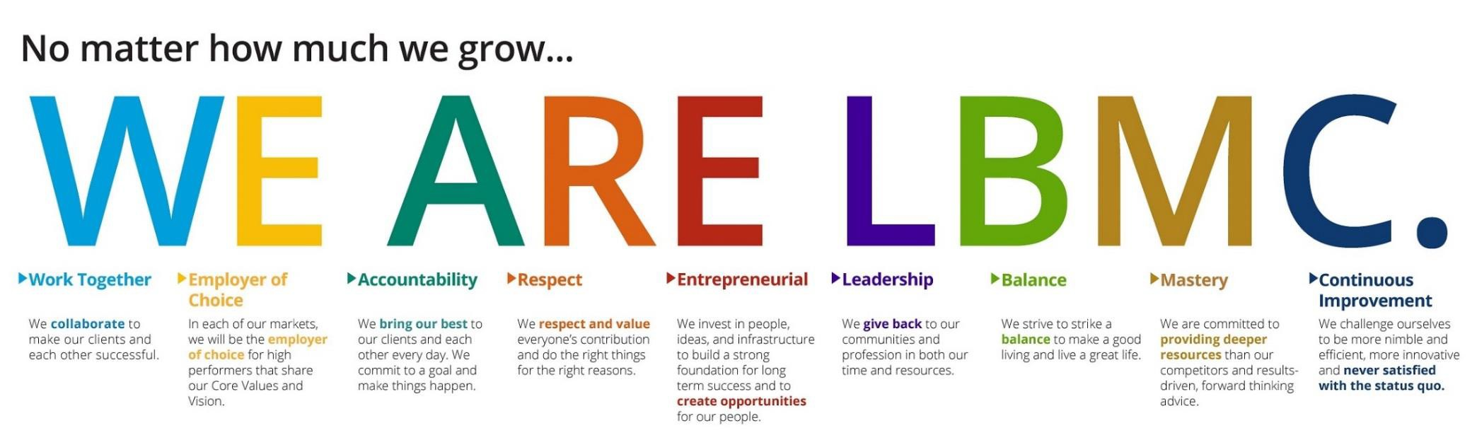
Our Values
Our core purpose is to make a
good business better.
Our shared vision is to make LBMC
the best choice for clients and colleagues.

Slide 5








Assurance
Transaction Services
Tax
Litigation Valuation
LBMC, PC
Healthcare Consulting
Information Security
State and Local Tax
Family Office

Slide 6





LBMC Technology Solutions, LLC
LBMC Employment Partners, LLC
LBMC Information Security, LLC
LBMC Staffing Solutions, LLC
Financial Services, LLC
LBMC Info Sec App, LLC
LBMC Physician Business Solutions , LLC
LBMC Investment Advisors, LLC
LBMC
W Squared, LLC
LBMC Procurement, LLC

Slide 7




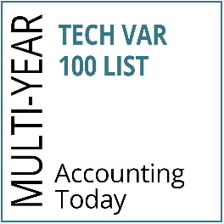


LBMC Technology Solutions LLC
BUSINESS & SOFTWARE
CONSULTING
Financial Software
(Intacct, Microsoft Dynamics 365, GP and SL)
Customer Relationship Management (CRM) software
(Microsoft Dynamics CRM, Salesforce) Enterprise Content Management
Software
(OnBase, Square 9, Box)
Office Automation Software (Office 365)
CLOUD COMPUTING & MANAGED SERVICES
On-Premise and Cloud Infrastructure Setup and Support (Amazon and Microsoft)
Remote Managed Services and Backup Solutions (TechCare)
Infrastructure as a Service Phone Systems (Digium)
Security Solutions
Outsourced CIO-level Services
SOFTWARE DEVELOPMENT
& BUSINESS INTELLIGENCE
Customized Software Development to include Mobile and Web Development
Business Intelligence (Power BI) & Data Warehousing
Microsoft SharePoint Services
Custom Integrations between line of Business Applications
Implementation and Support of Microsoft SQL Server and SQL Reporting Services
◆
◆
◆
◆
◆
◆
◆
◆
◆
◆
◆
◆
◆
◆
◆

Slide 8









LBMC Employment Partners LLC
THE LBMC DIFFERENCE
SERVICES
TRUSTED PARTNER
◆
Dedicated Human Resources Account Manager
Experienced and Knowledgeable Staff Strong Partnerships with BCBST and
Lincoln Financial Group
Partnership with Healthcare 21 Business Coalition (HC21)
Benefit Advocacy Services Health & Wellness Initiatives
Partnership with Zurich for Workers’
Compensation Insurance
Market Leader in the Professional
Service Industry
Recognized as a Member of the National Association of Professional Employer Organizations (NAPEO)
Innovative and Efficient User of Progressive Technology
◆
Certified Professional Employer Organization (CPEO)
Human Resources Outsourcing (HRO) Payroll Tax Outsourcing and Consulting Employee Benefits
Payroll Services
Human Resource Consulting
ACA Compliance Consulting and Tracking Services
◆
Our employees keep us on the road, and that makes them our greatest asset. We made a great business decision when we decided to hire LBMC Employment Partners to help us take care of those who take care of our customers.”
◆
◆
◆
◆
◆
◆
◆
◆
◆
◆
◆
– President & CEO, Distribution Service Company
◆
◆
◆
First CPEO certified provider in Tennessee

Slide 9



LBMC Staffing Solutions LLC
THE LBMC DIFFERENCE
CONTRACT PLACEMENT AND DIRECT HIRE POSITIONS
TRUSTED PARTNER
◆
Professional Recruiters with Expertise in
the Specific Disciplines for Which They Recruit
Expansive Candidate Referral Network through Affiliation with One of the Southeast’s Premier Financial Services Firms
Enhanced Employee Retention with Pre- Screened Candidates for Technical and Cultural Fit
Consultative Approach Supported by Market Knowledge and Industry Experience
Efficient Qualification, Selection and Presentation of Candidates
Accounting & Finance
Human Resources
Information Technology
Executive Administration
Key Specialized Manufacturing Roles
◆
◆
They are committed to excellence, and finding a “perfect fit” for our position that will be with us for years to come. The strong skills the LBMC team brings to the table make them outstanding at partnering with us to select individuals at all levels to join our team.”
–PHR Director of Human Resources, Healthcare Management Solutions Provider
◆
◆
◆
◆
◆
◆
◆

Slide 10

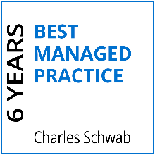



LBMC Investment Advisors LLC
INVESTMENT & ADVISORY SERVICES
Customized Investment Portfolios
Index ETFs and Individual Bonds
LBMC IA App
Coordinated Tax and Investment Advice

Slide 11


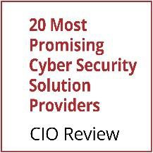

LBMC Information Security LLC
MANAGED SECURITY SERVICES
LBMC will minimize threats and respond with:
◆
Intrusion Prevention and Detection Services Security Information and Event Management Incident Response and Forensics Vulnerability and Threat Management
◆
◆
◆

Slide 12


LBMC W Squared LLC
Outsourced Finance
Outsourced Services
Our people, our processes and our infrastructure are ready to scale with you.
Strategic & Financial Management Services
CFO-level expertise & strategy
Comprehensive financial analysis (budgeting, forecasting & pro forma)
Preparation & process for future monetization event
Relationship management with private equity/venture capital partners
Investor pitch development
Capital funding strategy
Accounting Services
Comprehensive financial statement reporting (Analysis, KPIs, Board Package)
Month-end close & general ledger management
Accounts payable/receivable processing
Cash management
Electronic payments capability
Multi-entity consolidation & segment reporting
Tax & audit package preparation

Slide 13
LBMC Procurement Solutions LLC
PROCUREMENT SERVICES
Purchase like an enterprise.
Aggregating at SKU Level
Deeply Rooted Supply Base Relationships
Quarterly Business Review (QBR) Process for Suppliers
Client Partner Reporting
Negotiated Pricing with Extensive Supplier Network
Medical and Surgical Supplies and Equipment
National Lab Testing
Office Supplies
Lab Consumables
Small Package Shipping
Travel
Printed and Promotional Products
IT Software/Hardware
Office Renovations

Slide 14




LBMC Physician Business Solutions LLC
PHYSICIAN PRACTICE REVENUE CYCLE SOLUTIONS
PHYSICIAN MANAGEMENT SUPPORT & EMR SOLUTIONS
PHYSICIAN PRACTICE MANAGEMENT/ ADMINISTRATIVE OVERSIGHT
MEDICAL SERVICES ORGANIZATION (MSO)
Expert financial management
Everything you need to conquer billing, collections, claims processing
Efficient, cost-effective oversight with an eye to your bottom line
Comprehensive solution tailored to specific physician- related needs
◆ IT Solution Featuring Electronic Medical Records
◆ Revenue Cycle Staffing
◆ Claims Processing
◆ Accounts Receivable Management
◆ Patient Billing
◆ Payment Processing
◆ Monthly A/R Closeout Reporting
◆ Certified Coding Oversight
Electronic Medical Records
(EMR) Vendor Review
EMR Selection, Implementation and Management
IT Solutions
PMR-EMR-HER
Selection of PM/EMR Solution
Request for Proposal Development
Vendor Evaluation
Contract Negotiation
Implementation of PM/EMR, including:
Management Support
Regular Onsite Visits
Workflow Processes Management
Software Interface Management
Data Migration Supervision
Template Creation
Go LIVE Support
Administrative Oversight- Administrative Consulting Services to Support Practice Leaders
Financial and Operational Consulting
Human Resources Services
Coding, Billing, Corporate Compliance including ICD-10 Implementation and Training
MACRA/MIPS
Physician Practice Billing/Collection Services
Benefits and Human Resources Services (HRO/PEO)
Physician Practice Management and Administrative Oversight
Coding/Compliance Services
Practice Management Consulting, as needed
Outsourced Accounting
GPO

Slide 15

BALLAST
BALLAST
Automating and Empowering Risk Management
Reducing Assessment Fatigue
Software as a Service
Subscription-based
Automated Assessments for:
Cyber Risk
Compliance
Vendor Risk
Operational Controls
Client Defined/Custom
Dashboard Reporting
Remediation Management and Tracking
Repository for Assessment Evidence
Versions available for
End-user organizations
3rd Party Assessors & Consultants

Slide 16
Agenda
History of the Spreadsheet
Manual Processes
Automation
Automation with AI and ML

Slide 17
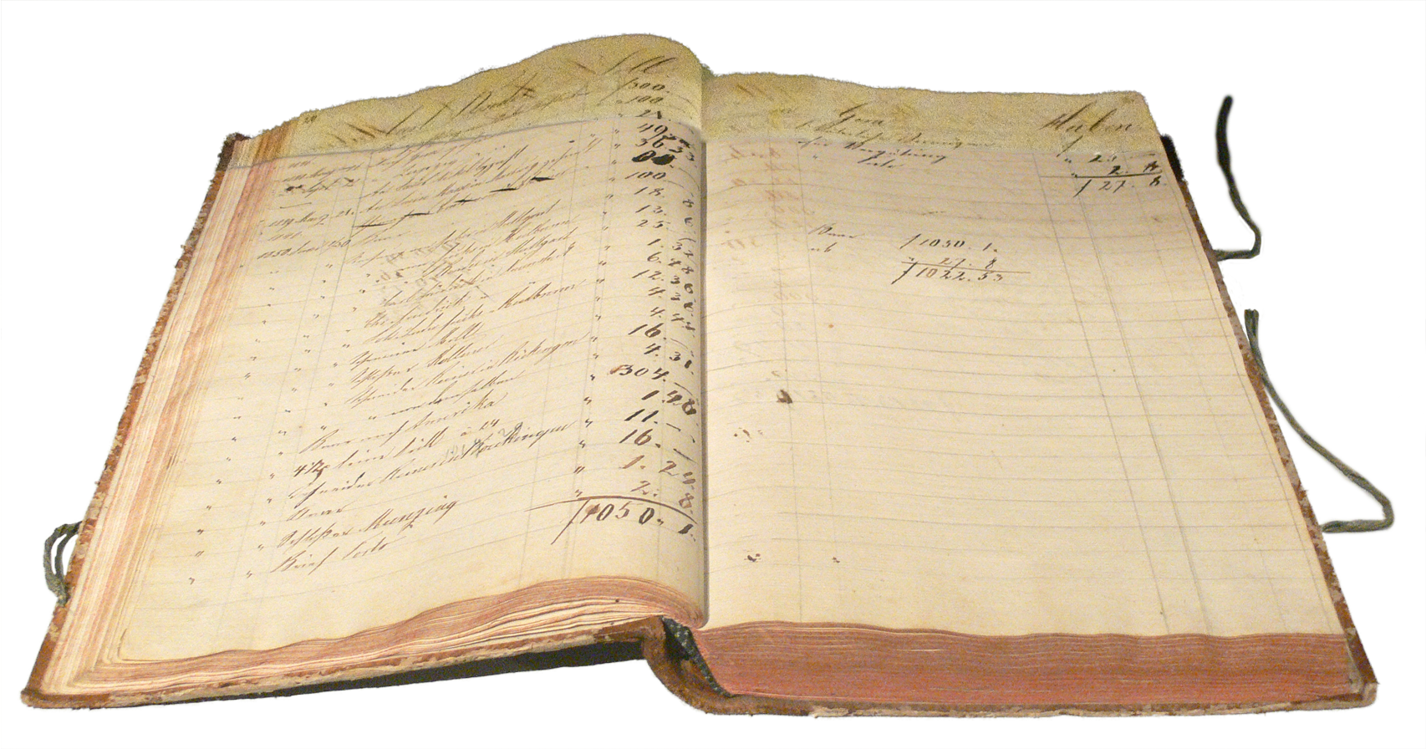
Land before the computer
Before computers, ledgers were kept on sheets that spread across the centerfold
Hence the name spreadsheet
Calculations had to be done by hand and a single error could effect many downstream calculations
This would require a lot of re-work
Very time consuming!

Slide 18
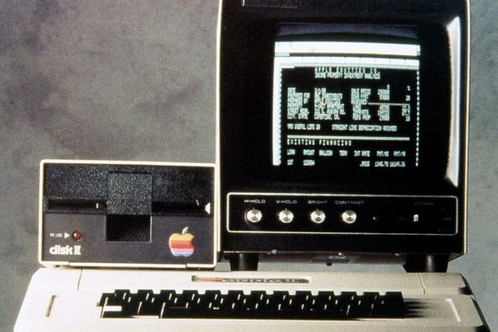
Early computer Spreadsheets
The first spreadsheet application on a personal computer was VisiCalc
The democratized the computer spreadsheet!
Apple II – 1979
Conceived Dan Bricklin
The personal computer and spreadsheet software allowed businesses to quickly digitize
Notes:
Dan went to Harvard Business School, after graduating from MIT and working on word processing systems.
Had to do case studies and run calculations manually and present to the class
Frustrated when he did all the homework only to find out the next-day he made an error early on and all his numbers were wrong
During class he would daydream and imagined a magic blackboard where he could update one number and all the others would update
Built a prototype to figure out how this could be done
He had a case study on Pepsi and presented 5-year projections and many different scenarios (he did want to tell his professor he had written software to do that for him)

Slide 19
Fast-Forward
Today a lot of spreadsheet work is done using Microsoft Excel
Excel has evolved from a simple spreadsheet tool into a data tool
Today users can quickly import data from other sources and quickly begin working with that data
While quick and easy, this can create problems if you’re not careful
Manual Process
Conflicting reports
Scalability issues
Notes:
Data Tool
Excel has Power Pivot for building data models with metrics and Power Query to extract and transform data

Slide 20
Manually Gathering Data
The need to gather data to make informed decisions is high
However, in many organizations data is not centralized or managed in a way that is consumable by the business
Especially true in younger organization
This causes users to gather their own data from source systems, and transform it to meet their needs
This can cost many hours to put this information together
And must be done each time you want the information updated
Notes:
Client spent 4-5 hours extracting and manually massaging data every time they wanted to see updated figures
A lot of time was spent “figuring out” the data (which fields in the database corresponded to which fields/flags in the User Interface)
Data was only ever looked at once every two weeks. Could only be reactive, never proactive or quick to address issues

Slide 21
Sharing Manually Collected Data
Eventually this manually curated data is disseminated throughout the organization, or even externally
This can result in others building reports from other’s manual processes
Which are then shared, compounding the problem
In some cases, a single metric can be generated from different processes resulting in inconsistent information.
Notes:
Ever heard of a business that “ran on Excel”
Creates a web of information dissemination
Difficult to audit, and a nightmare if issues are found in downstream calculations (It’s the paper spreadsheet all over again)
Early days at a previous job, we had two analyst produce two different methods to do an Admits per K metric. The result was two slightly different numbers for the same metric that was difficult to explain. Solution was to build a model that did the calculation for them

Slide 22
Scaling Manual Processes
After some time, there may be to much data to process on a work computer
Your computer only has so much capacity
Eventually this data moves into a database system
SQL Server, PostgreSQL, ect.
Now you need to have processes that load data in and extract data out...
And next thing you know, you’re a programmer!
Notes:
Large amounts of data, can’t easily fit into excel
Once had a spreadsheet with so many calculations that you’d open it up get a cup of coffee, come back and it still wouldn’t be open.

Slide 23
How do we fix this?
Automation!
Automation!
Automation!
Notes:
Like the 3 L’s of Real Estate
Why Automate?
Creates defined processes that are followed exactly
Completely auditable (I can tell what happened on a specific execution based on the version of code being used)

Slide 24
ETL Processes
Define Extract, Transform, and Load (ETL) processes to replace the manual gathering and massaging of data.
We want people to spend 20% of the time getting the information they need and 80% of the time gaining insights
Typically, organizations will have a team with its IT departments
Very important that the business and IT works together
They know the technical capabilities
You know the business and the data
Centralize your data in a data warehouse

Slide 25
Workflow Automation
Some data processes are not ETL processes
Approval workflows
Workflows based on receiving an Email
Responding to when a file is updated
Microsoft provides a tool to facilitate this called Power Automate
DEMO
Notes:
Demo running the flow
Walk through the flow UI
Create another flow to show how easy it is!

Slide 26

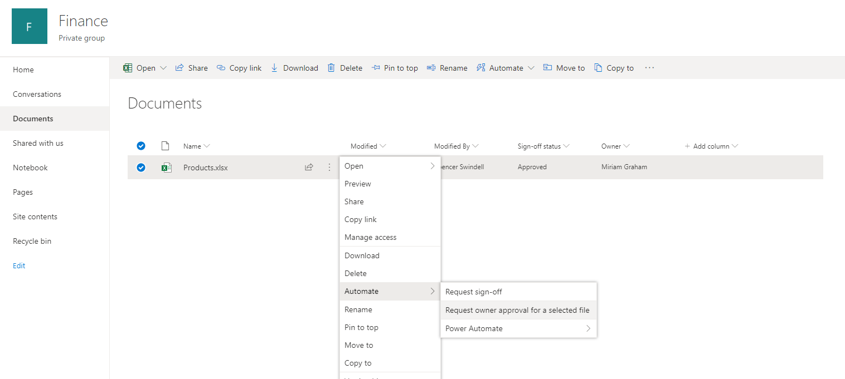




Slide 27
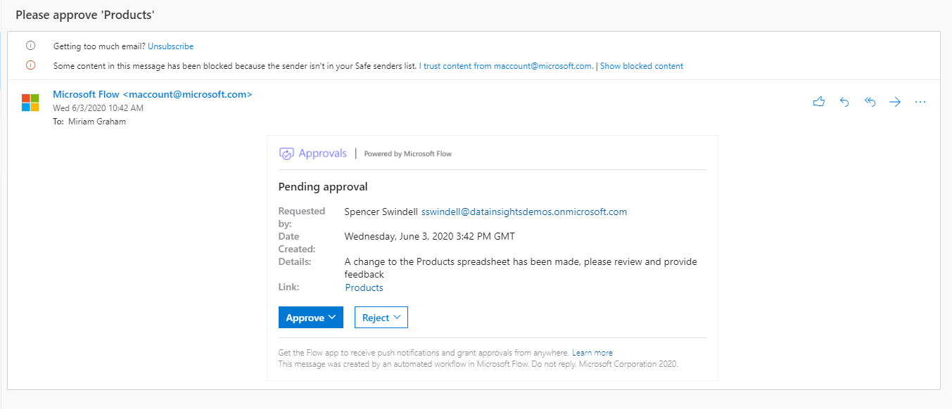

Slide 28
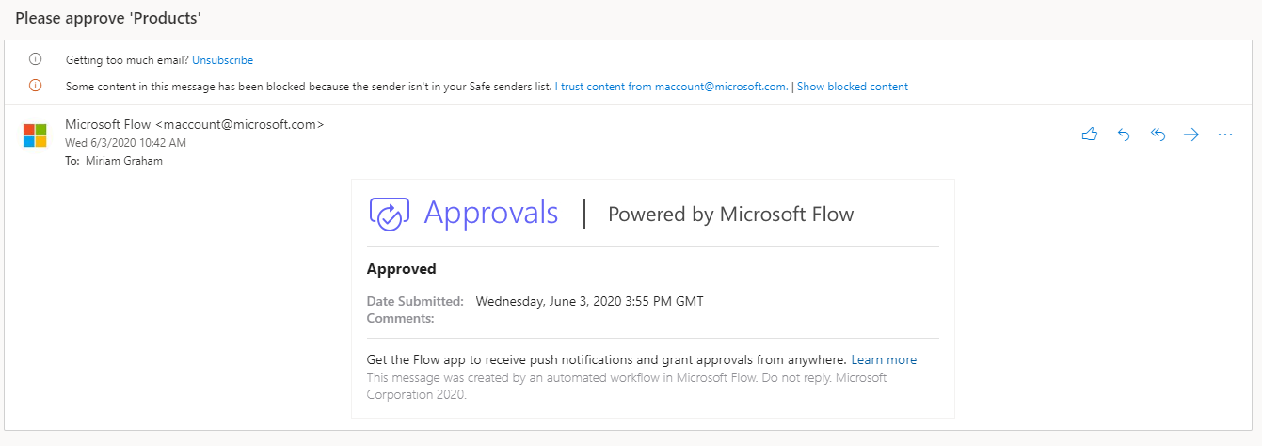

Slide 29
Reporting Automation
We’ve automated data movement and processes
Consuming information consistently using predefined data models
Power BI enables self-service analytics
Define your own reports from centralized models
Share reports with other teams
DEMO
Notes:
Show Power BI Desktop
Authoring a model
Build a new report page
Publish to PowerBI
Analyze in Excel
Author new PowerBI report re-using the same model

Slide 30
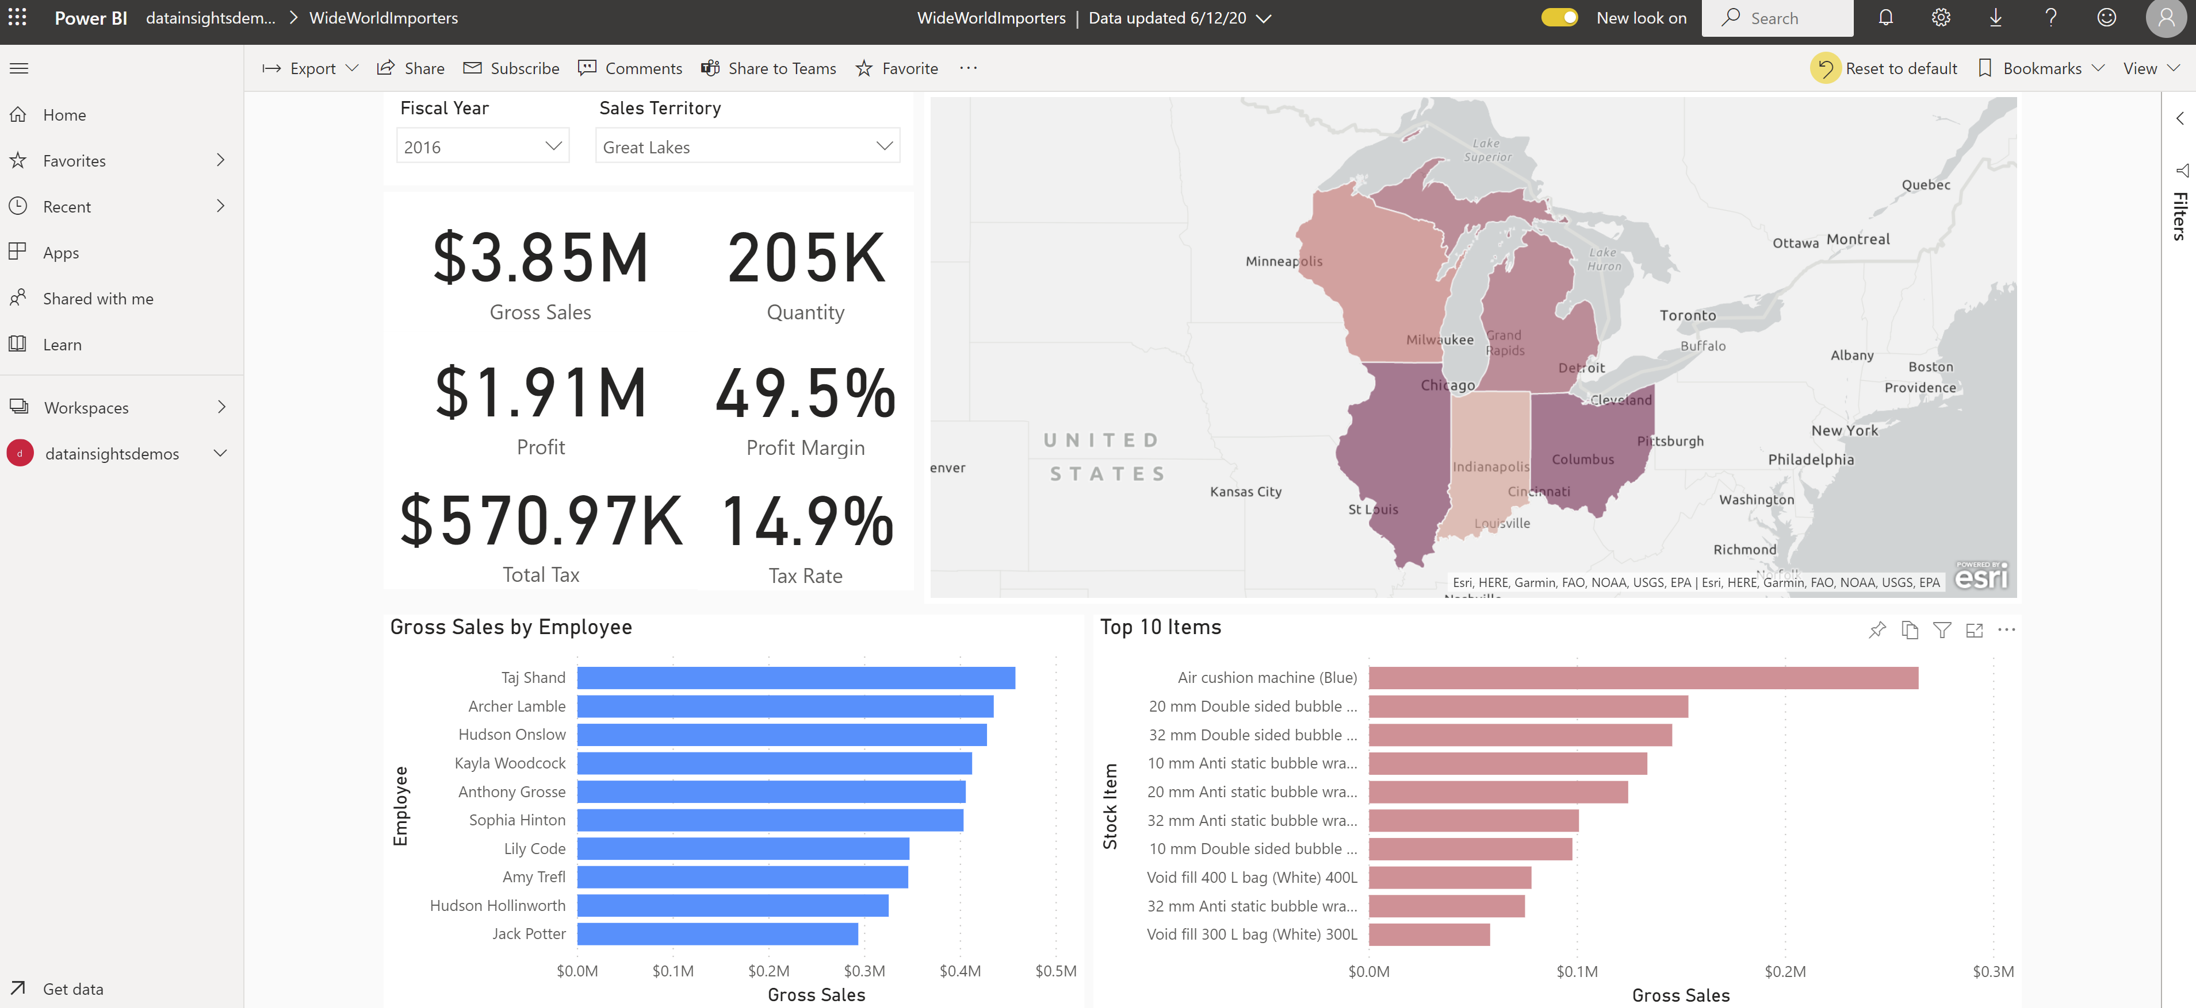

Slide 31
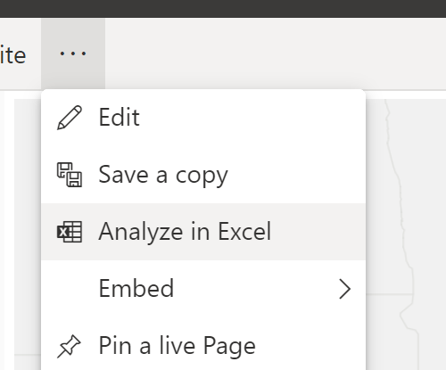

Slide 32


Slide 33
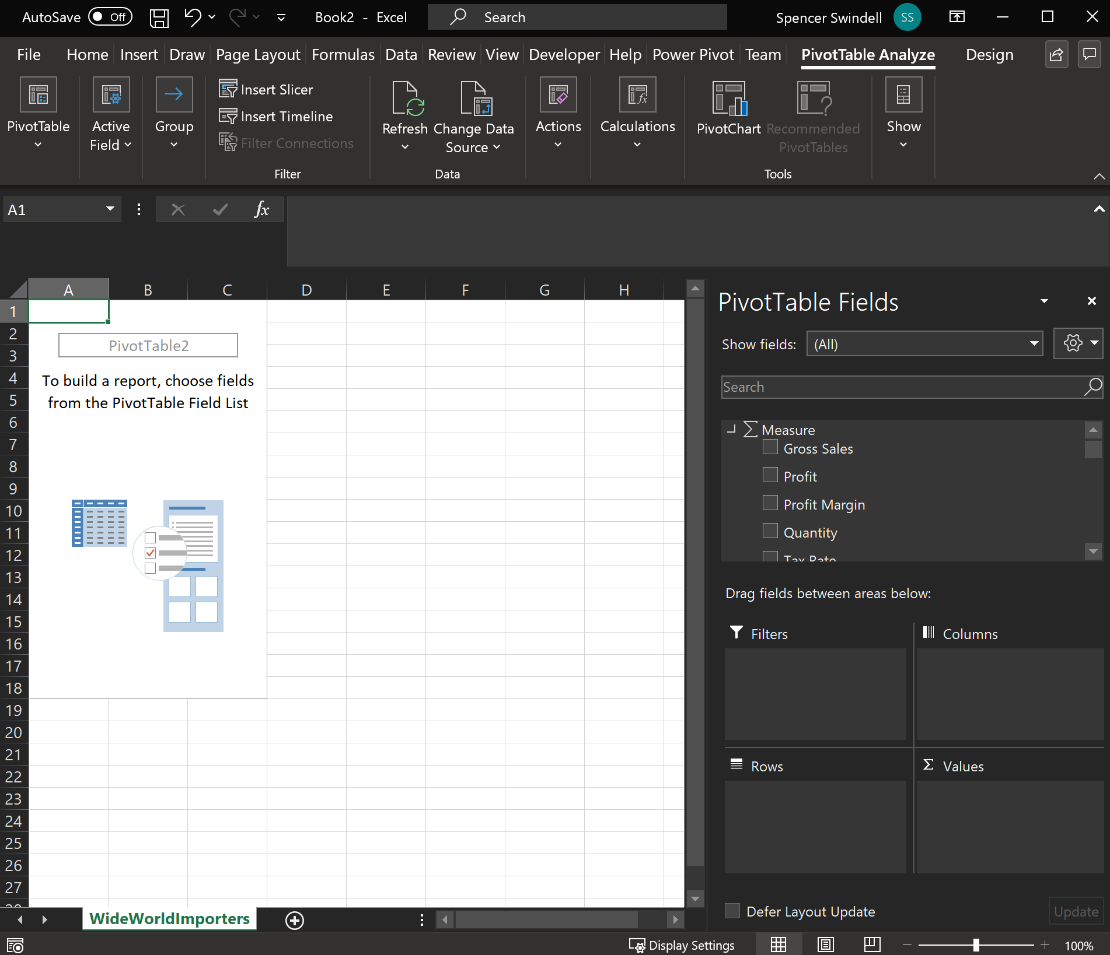

Slide 34
More Automation
Sometimes it’s difficult to automate a process
Working with older systems with no API
Extracting information from a website
Robotic Process Automation can help!
DEMO
Notes:
Show the RPA in action
Show building the UI flow
Show the flow that runs the UI Flow

Slide 35
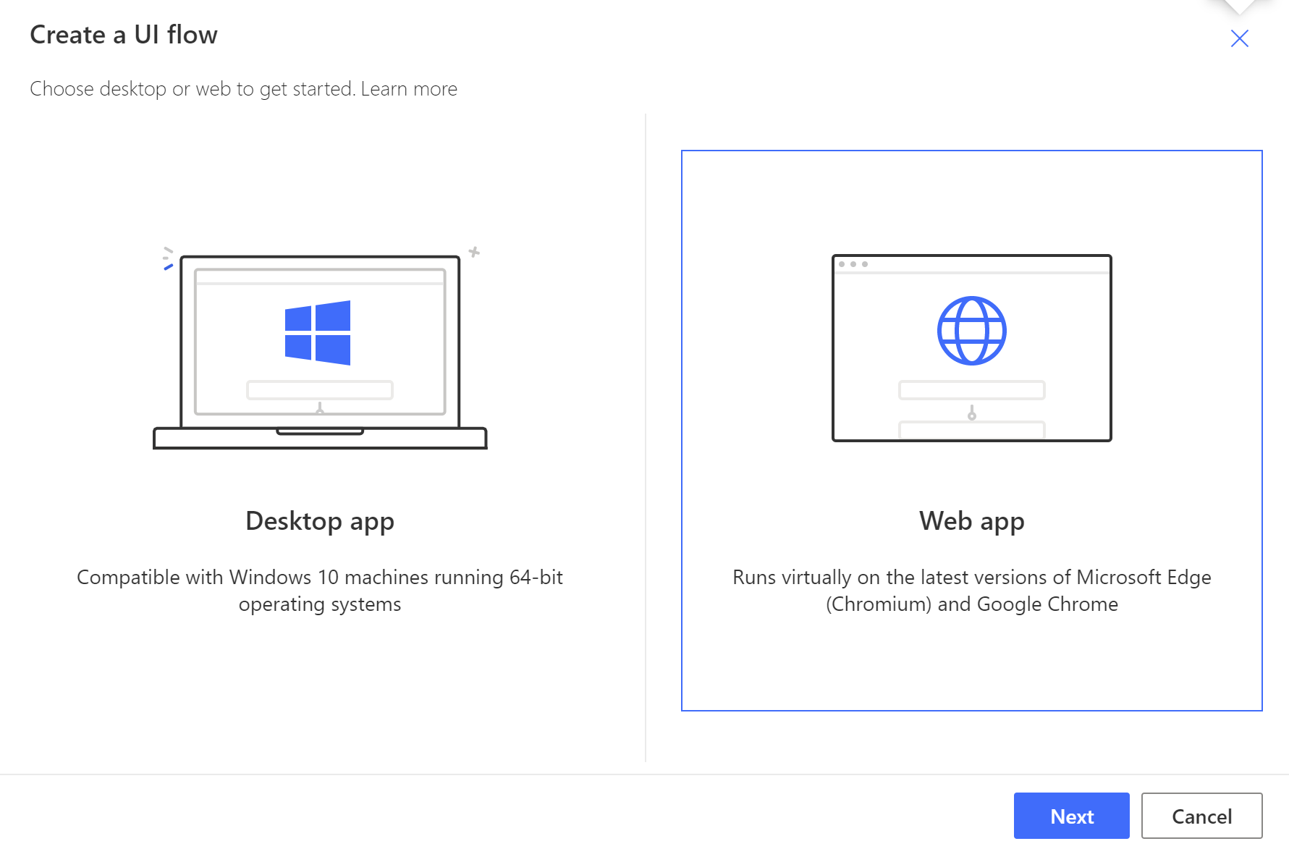

Slide 36
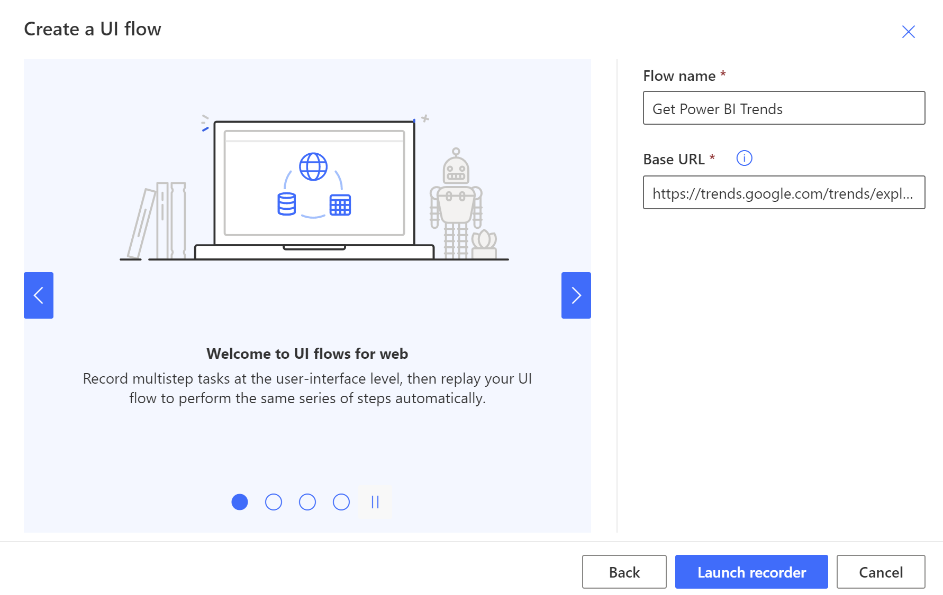

Slide 37
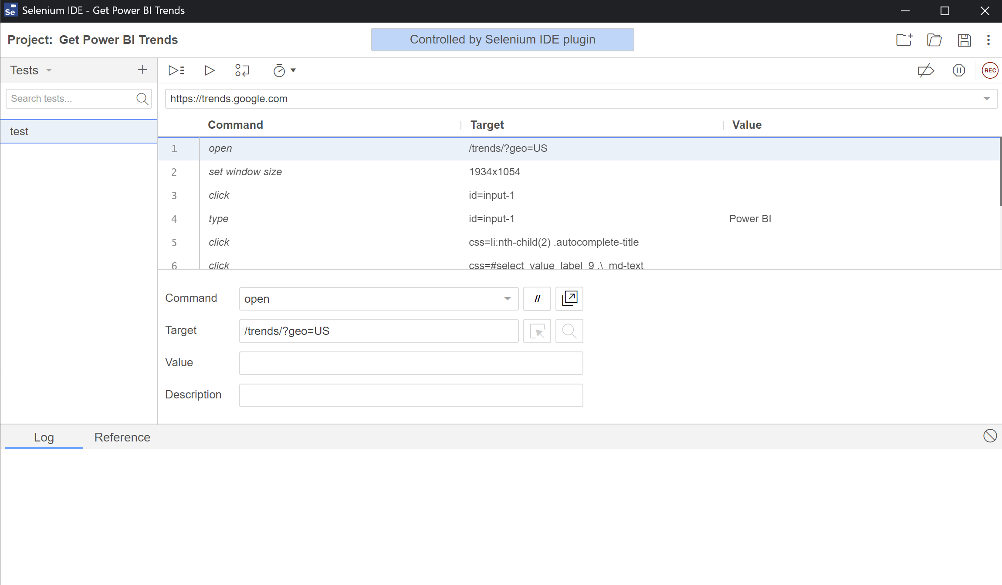

Slide 38
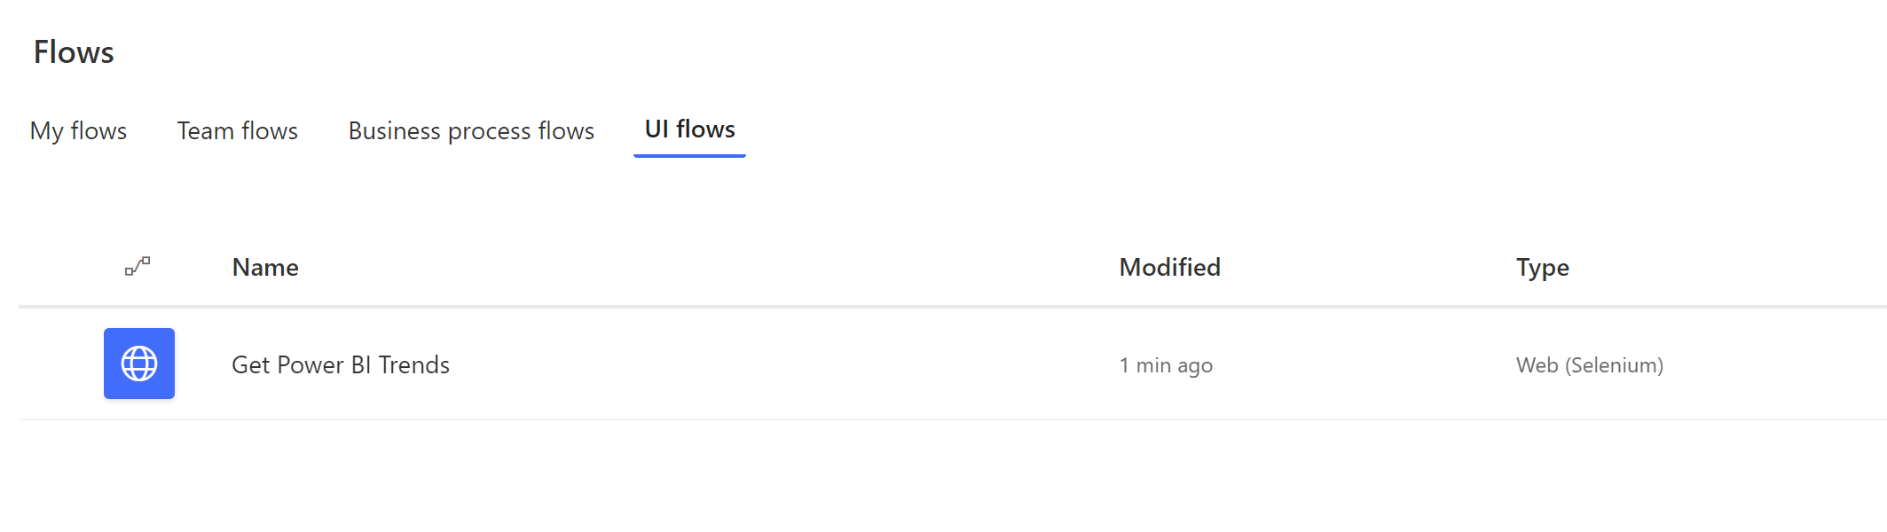

Slide 39
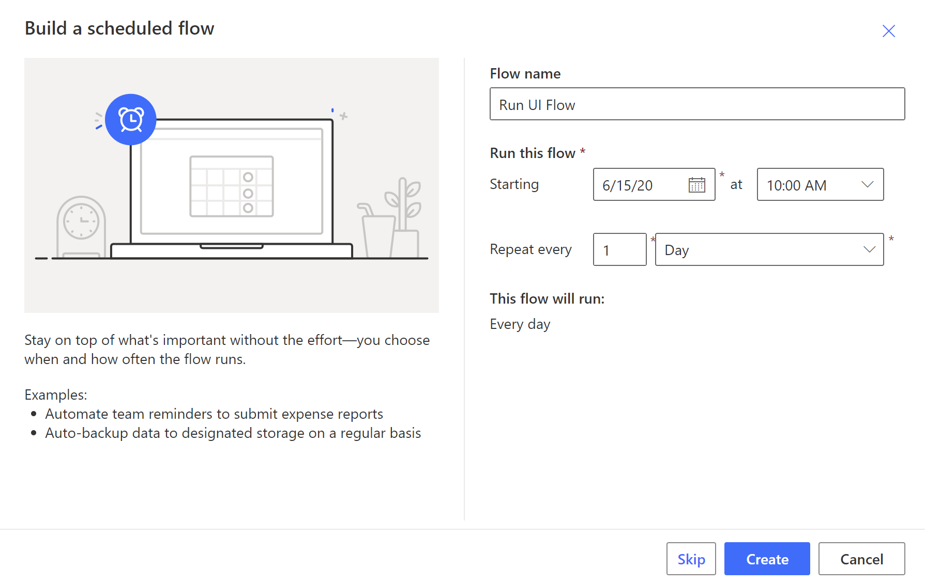

Slide 40
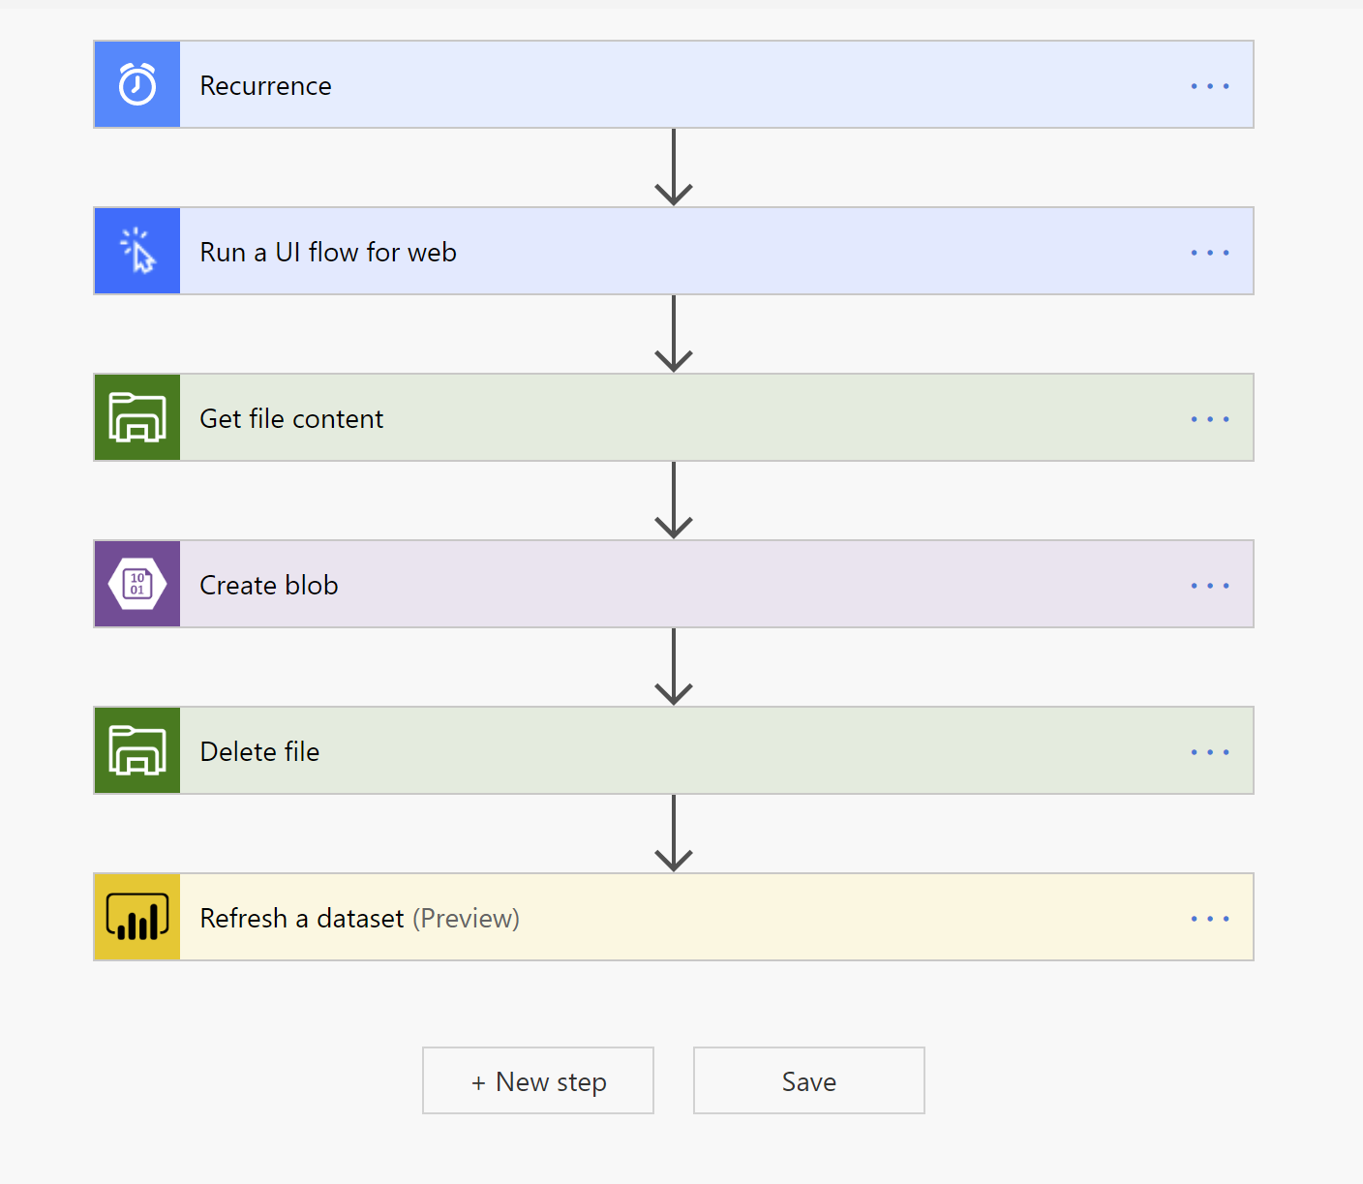

Slide 41
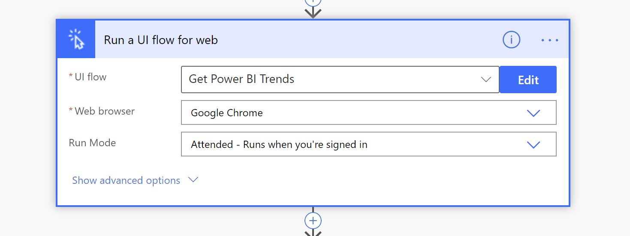

Slide 42
Even More Automation
What about getting information from faxes or scanned documents?
New services in the cloud can easily provide the technology to extract this information from text
Microsoft Cognitive Services
Provides API’s for
Computer Vision
Speech
Language
Search
Decision
DEMO
Notes:
Show the image and Run the code
So that it pulls the balance
Show AI builder in Power Automate

